Slide 1
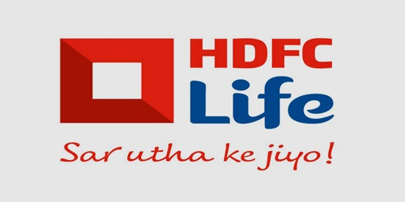
HDFC Life Insurance Co. Ltd.
By - Vedant Garg 201102

Slide 2
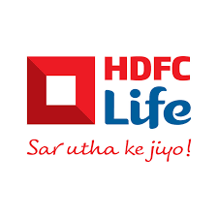
Introduction
Hdfc Life Insurance Company Limited is a long-term life insurance provider, offering individual and group insurance services. It was incorporated on 14th August, 2000 becoming the first private sector life insurance company in India.
The company is a joint venture between Housing Development Finance Corporation Lth (HDFC), one of INDIA’s leading housing finance institutions and Standard Life Aberdeen, a global investment company.
The managing director & CEO of the company is Vibha Padalkar, Executive Director is Suresh Badami, Chairman Deepak S.Parekh. The company has it headquarters situated in Mumbai, India.

Slide 3
Introduction
HDFC Life distributes its products through a multi channel network consisting of insurance agents, Bancassurance partners, insurance brokers, micro finance institutions, etc. They also have there online platform - hdfclife.com
Hdfc Life products include Protection, Pension, Savings, Investment, Health along with children and women plans.
Hdfc Life has 421 branches and is present in 980+ cities, villages & towns in India and supported by 166544 employees. The company has set up a liaison office in Dubai.

Slide 4
Comparison with peers:
Insurance Regulatory and Development Authority of India(IRDAI) regulates the insurance industry in the country. As of now, 23 private companies and one public company is approved for providing insurance services.
LIC India, the only public company, is owned by Government of India. It is biggest company in terms of no of claims received. It is so bigger that it surpasses the combined figures of all the 23 private companies.
MAX Life, SBI Life, Kotak Mahindra, ICICI Prudential and HDFC Life are some other big names in industry in terms of no. of claims received. Following is the analysis on basis of some fundamental ratios.

Slide 5
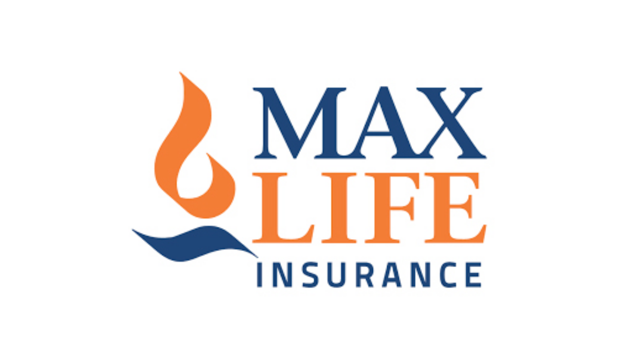
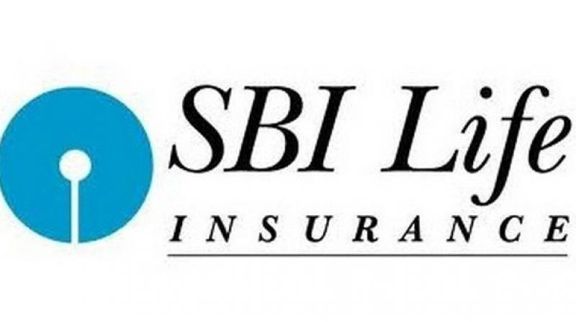
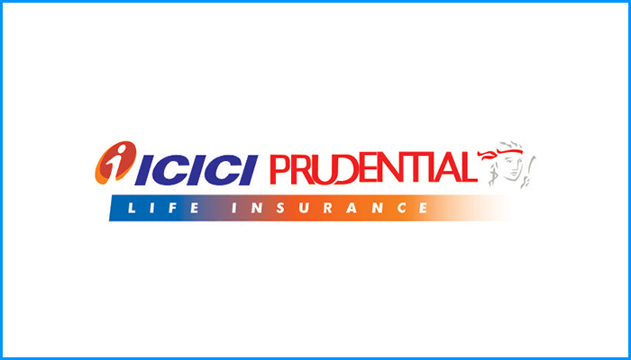
Rivalries
SBI Life Insurance
SBI Life is perceived as one of HDFC Life's biggest rivals. Like HDFC Life, SBI Life also operates in the Life & Health Insurance industry. SBI Life generates 115% the revenue of HDFC Life.
ICICI Prudential Life Insurance
ICICI Prudential Life Insurance is one of HDFC Life's top competitors. ICICI Prudential Life Insurance is a Public company that was founded in 2000. Like HDFC Life, ICICI Prudential Life Insurance also operates in the Life & Health Insurance field. Compared to HDFC Life, ICICI Prudential Life Insurance has 5,627 fewer employees.
Max Life Insurance
Max Life insurance has been one of HDFC Life's top competitors. Max Life insurance also works within the Life & Health Insurance field. Max Life insurance generates $7.1B less revenue than HDFC Life.

Slide 6
Claim : Application for reimbursement of insurance from company.
Claim available for processing : pending claims from past year + new claims this year.
Claim settlement : Approval of claims by company and paying off the due amount.
Claim rejection : Rejection of application due to some mistake, incomplete documentation or some technical reasons; before processing.
Claim repudiation : The concerned event is not listed in company's liabilities, and hence application is processed but not approved.
Terminology

Slide 7
Solvency ratio : Extent to which the assets can be used to pay future dividends, without other revenues. According to standards, this ratio must be greater than 1.5.
Claim settlement ratio : Percentage of claims settled out of total available claims for processing. Higher the ratio, better the company.
Important ratios

Slide 8
Claim repudiation ratio : Percentage of claims repudiated from total no of claims. Lower the ratio, better the company.
Claim rejection ratio : Percentage of claims rejected by company, from total processed claims. This ratio should also be lower.
Claim settlement ratio(in terms of amt) : Percentage of amount paid from total claimed amount. For big companies, this is more important than CSR.

Slide 9
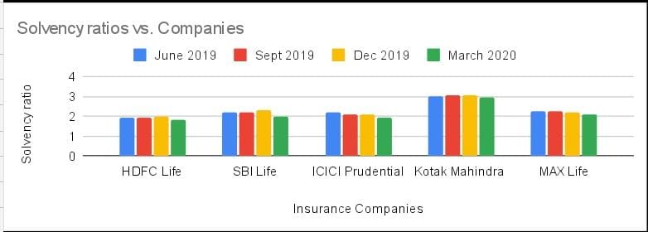
Solvency ratio
Solvency ratio is proportional to extent of ability of the company to manage its future liabilities using its assets. According to standards, insurers must maintain a minimum solvency rate of 1.5.
As we can see from the graph, all these companies are well above the govt standards. Kotak Mahindra has excellent solvency ratio of 3+ consistently. HDFC Life has a good solvency of above 1.5, but it remains marginally above the limit. So, an investor would like to ensure that their won't be any mishaps in near future that will affect the business of company.

Slide 10
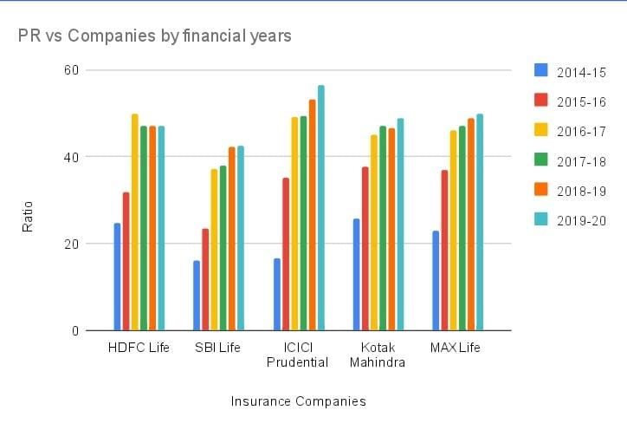
Persistency ratio
Persistency ratio denotes percentage of clients that continued paying the renewal amount after each year. For every financial year, the ratio is calculated after 13th, 25th, 37th, 49th and 61st month. It is calculated by considering total no of policies issued during that financial year as base number. Numerator contains no of renewals after the given time interval. Since, renewing the policy for 5 years is indicator of customer satisfaction, " Higher the persistency ratio, better the company is.”
HDFC Life maintained a good persistency ratio of around 50% from last 4 years. This indicates a satisfactory service provided by the company. From investor point of view, it is a plus point as more popular the company is, better the results will be.

Slide 11
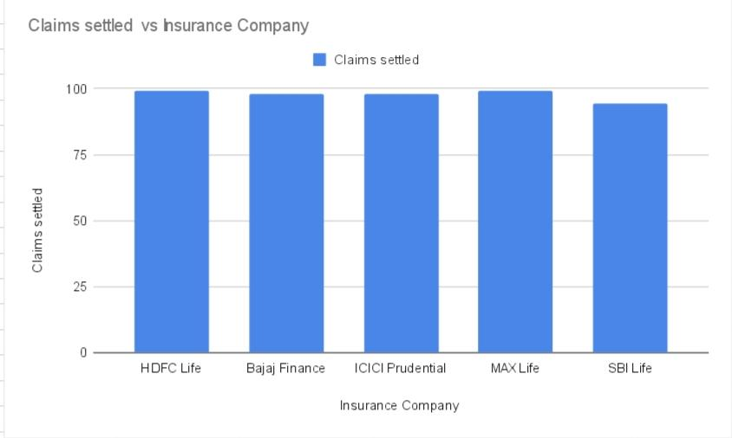
Claim settlement ratio : Percentage of claims settled out of available claims to process, is known as claim settlement ratio. This ratio is calculated in two ways: in terms of policies or in terms of premium paid. In both cases, as high the ratio will be, the company is more trustworthy of paying you the insured amount. From the graphs, it is evident that HDFC Life is very keen on settling the claims. It stands 2nd among 23 companies, in terms of claim settlement ratio.
Claim settlement ratio

Slide 12
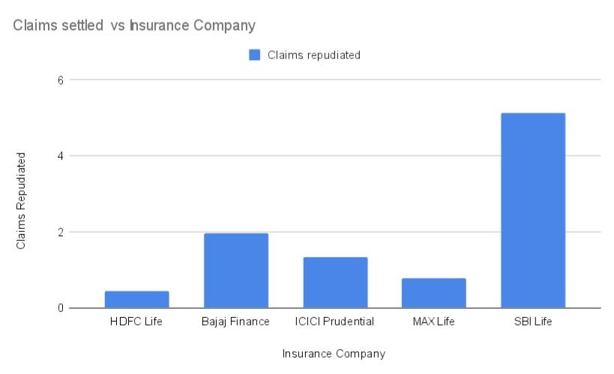
Claim Repudiation Ratio : Some claims are found out to be invalid after processing, i.e. the event that caused the death of the individual isn’t a company’s liability. Such claims are said to be Repudiated claims. There is another term, called Rejected claims, which refers to invalid applications which were not processed due to incomplete documentation or mistakes in application or any other technical errors in the filed application. Both these numbers should be smaller, if a company is to be classified as a good company. As it can be seen from graph, HDFC Life has lowest claim repudiation ratio.
Claim repudiation ratio

Slide 13
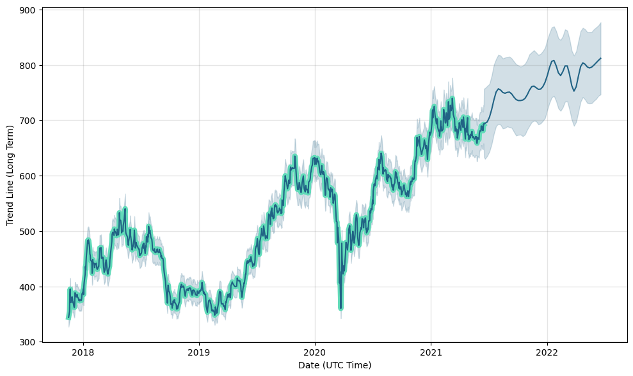
Future Predictions…
Buy or Sell HDFC Life Insurance Stock?? … This is the most basic question comes to find while investing. HDFC Life Insurance has been involved in a rapid growing competition with ICICI & other rivals over the year. In recent times, there has been a slow downfall in the stock prices due to financial rivals but in the long run, I expect HDFC Life insurance share prices to go up. I also expect the impact of COVID on the life insurance industry has been a positive one and owing to such diseases shareholders will more likely invest in the company. In the future the HDFC shares will be good for investing also the demand for life insurance will increase soon. Below is the forecast for the near future years:-

Slide 14
Future Predictions Contd.
HDFC Life is a provider of life insurance services for individuals and businesses. With an annual revenue of $9.7B and over 20,000 employees HDFC Life Insurance firm is a steady sailing ship aiming to capitalise and strengthen its positions as the most trusted life insurance brand among the customers as well other firms.
With a CEO Rating of 79/100 Vibha Padalkar has done a decent job at maintaining the company’s position in the market. Also, over the year HDFC Life Insurance hasn’t done any business acquisition or Funding in stocks market related affairs. HDFC Life Insurance has been one of those companies which as been in constant demand among common people as well reputed firms, as a result they have built a feeling of trust among their customers which has led to there growth. In the shorter period there has been a bit of decline in HDFC Life Insurance stock prices with SBI gaining the lead over them but still I firmly believe that HDFC is a tough competitor backing it’s strong policies and in the future we can see a tough fight between HDFC Life and SBI Life for the throne of Health Insurance leader brand in INDIA. HDFC Life has just been more successful than others in pushing plain term plans. I believe that there will be long term growth in HDFC Life’s stock prices

Slide 15
The COVID-19 IMPACT!!
The business contingency plan was put in motion and tested during the covid period. The initial focus was to ensure the safety of the employees and providing seamless services to the existing customers. Enhancing the already digitized customer journey for the new as well as the existing customers helped HDFC Life Insurance to maximize renewal premiums
The Covid Impact stuck a hard blow on the industry but HDFC Life Insurance Co. Ltd. adapted rather quickly than the market. They believed in the adoption of digital assets by there distributors, partners & customers which helped them significantly.
Over the Long term period they expect the life insurance industry will bloom on the back of robust demographic changes and financialization of savings and growing need of digitalization among other factors. There past investments in technology helped greatly to develop a safe online environment for the communication and to carry on the proceedings and the paperwork.

Slide 16
Management Performance!!...
Hdfc Co. Ltd. witnessed significant healthy growth during the FY2020 in terms of new business premiums despite challenges in the broader financial services market.
The Bombay Stock Exchange(BSE) & National Stock Exchange(NSE) values as of 25th June were 725.55 & 725.95 respectively.
The company has been successful in maintaining a profitable growth in all sectors. The Life insurance sectors witnessed significant growth potential due to the under penetration and robust demographic trends, People are investing in life insurance plans to ensure their families safety and a healthy future in case of an unfortunate mishap.Also, The management is confident of delivering value to customers and a profitable growth to the shareholders moving forward as well.
Fortunately, The company has never come under the scanner due to fraud or mishap till now.

Slide 17
Management Performance!!... Contd.
Large market size - The number of people above the age of 60 years is expected to triple by 2050 as compared to 2015, thus providing insurers an opportunity to tap the retirement space by way of offering long-term income and annuity products.
Indian insurance sector Underpenetrated - As compared to other developed economies, India remains vastly under-insured, both in terms of penetration and density. The ?protection gap? in India is amongst the highest in the world at 92.2% as of 2014
Healthy growth - During FY 2020, the life insurance industry grew by 21% to garner ` 2,589 billion of new business premium against ` 2,147 billion in the previous financial year. Private insurers grew by 5% in individual business while group business saw a growth of 19%.

Slide 18
THANK YOU...

